Slide 1

Cashier Training

Slide 2
Cashier Expectations
Provide excellent customer service
I value every individual’s right to have a quality experience – You are usually the first employee that a guest interacts with. Your goal as a cashier is to start their quality experience with a positive first impression, an upbeat welcome/greeting and by using your manners.
Have a neat and clean uniform and adhere to all of Dining Services’ uniform policies.
Smile – it’s the most important part of your uniform.
Greeting – “Hi, how are you today?”
Ask the guest what they would like instead of what they want.
Remember to use “Please, thank you, yes, no”
Make eye contact.
The Three Keys to Customer Service
Greet – greet each customer, make sure the customer has your undivided attention
Listen – listen to their order, repeat it back; make sure you under their question(s) or any requests
Respond – take the appropriate action necessary to honor their request.

Slide 3
Cashier Expectations
Know and understand the menu, especially any daily specials being offered in your shop.
Guests will ask you many different questions related to the menu in your shop. It will benefit you and the improve the guest’s experience if you know as much as possible about the items your sell.
If you are asked a question and you do not know the answer, please make sure you find the correct answer by asking a co-worker, supervisor, manager or Chef. NEVER GUESS!!! You never know when someone is asking because they have a food allergy.
Never answer a guest’s questions with “I don’t know” unless it’s followed by “but I’ll find out for you.” Then you must do just that…find the answer.
You also need to know how to ring up any specials being offered in your shop.
Adhere to and enforce all of Dining Service’s cash handling policies. Failure to follow and enforce policies will result in disciplinary action, up to and including termination.
When asked to do something that is against one of our policies, please explain why we can’t accommodate that request to the guest. Don’t say “it’s against our policy.”
Offer an alternative solution.
Always make good eye contact with the guest.

Slide 4
100% satisfaction guarantee
Dining Services has a 100% satisfaction guarantee on our products and services.
This means that if a customer is not satisfied with any part of their meal, we do what we can to correct the problem.
Every guest should leave happy.
As a cashier and dining services employee, you are empowered to correct the problem (with in reason).
If someone complains that they don’t like the food, offer to make them something different, free of charge.
A good rule of thumb is to make sure the item costs approximately the same thing. Ex. A cookie for a cookie or cupcake, pizza for pizza, pasta for pasta, hamburger for hamburger or quesadilla, etc. We can’t give someone who is unhappy with a smoothie a lobster…
Don’t hesitate to get a manager or supervisor involved if needed.
Managers will need to perform any refunds needed.

Slide 5
Cash handling polices and procedures
Method of Payment
West End Market is a “cashless” facility, meaning we do not accept cash or checks for payment. We accept:
Hokie Passports (Meal Plans, Hokie Passport, Dining Dollars, Commuter Cash, etc.)
Visa
MasterCard
Discover
We DO NOT accept American Express.

Slide 6
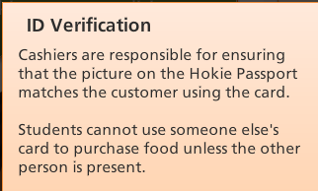
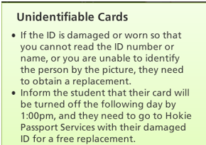
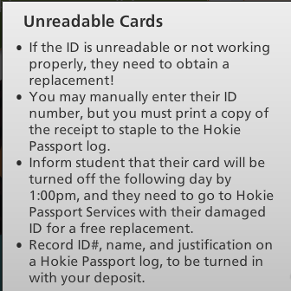
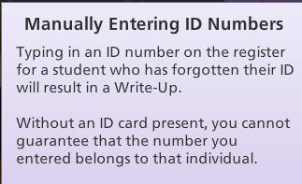
Cash handling polices and procedures
If a Hokie Passport is present, but not reading when swiped, you must get a manager so the payment can be processed. Only a manager can manually enter in their ID number.

Slide 7
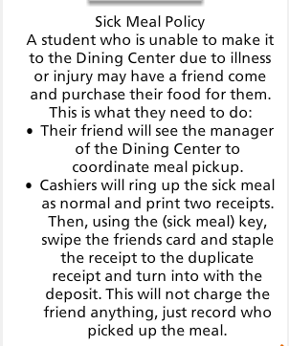
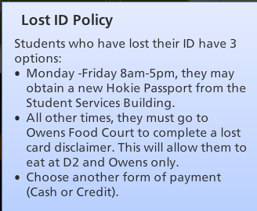
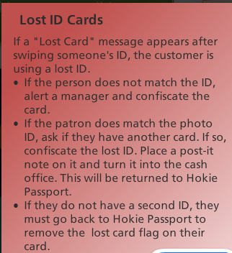
Cash handling polices and procedures
Micros – we use a Micros operating system with a touch screen. Only finger tips should be used on the touchscreens; no pens, pencils, clerk cards or sharp objects should be used on the screen.
Overages/Shortages – Cashier will receive a counseling memo for any overages or shortages in excess of $5.00.
Cashiers who receive three counseling memos will be removed from the cashier position or terminated, depending on the severity of the overage or shortage.

Slide 8
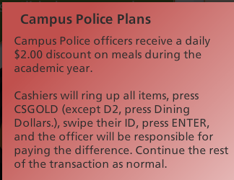
Cash handling polices and procedures
Receipts
Every customer receives a receipt for their purchase(s).
Do not ask if the customer wants a receipt. They have the ability to throw away any unwanted receipts.
Each shop at West End Market gives customers’ their receipts at different times in the ordering process. Some give you a receipt when you pay, others give you a receipt when you pick up your food. This will be explained to you when you are completing your in shop training.
Make sure you have at least 2 rolls of Micros receipt paper at your register before you being your shift as a cashier. It’s a big inconvenience to stop the line and make customers wait while you get more receipt paper.
Receipt paper can be retrieved from the kiosk.
Also make sure you have someone show you how to change the receipt paper.

Slide 9
Employee Meal policies
As a cashier, you are responsible for following and enforcing all employee meal policies. Failure to do so can result in disciplinary action, up to and including termination.
We do not accept meal passes from any other dining unit on campus.
All wage and salaried employees at West End Market use their Hokie Passports to pay for their employee meal. There are times that they will use a West End Market meal card instead of their Hokie Passport. Students will be issued a West End Market meal card to purchase their food. These employee meal plan funds will only work at West End Market.
Each employee has a meal allowance of $8.50. For any purchase over $8.50, the employee is responsible for paying for the remaining balance with other (Hokie Passport, Dining Dollars, Flex, or Credit Card) funds.
Food bought with meal plan funds is not permitted to leave the building (unless purchased by a student). If any employee wishes to purchase food to take home, they must pay with funds other than meal plan money and they should keep the receipt and the food together in case any questions should arise.

Slide 10
Employee Meal policies
Employees are not allowed to purchase any pre-packaged food items (except chips – one bag per day and milk), bottled drinks (including Hokie water), lobster, steak, fish or high end cakes and pies. Allowing an employee to purchase these items with employee meal plan funds will result in disciplinary action, up to and including termination.
Sharing of meal plan funds is not allowed.
If Joe wants a cupcake but doesn’t have enough money left on his employee meal plan, Jane can’t use her employee meal plans to cover the difference. Jane can use her Hokie Passport, personal meal plan, or Dining Dollars to cover Joe.
Giving away soda and water cups to customers is considered theft and will be dealt with as such.
Dining Service employees who are using a meal pass are allowed a free drink. West End employees who are currently working a shift are also allowed free drink.
When students (they are the only ones who are allowed to take their meals to go) are using their employee meal pass during normal operating hours and order their food to go, they need to be charged (if applicable) for to go boxes because they are choosing to take their food to go.
Only at the end of the night are students to take their food to go and not get charged for a to go box.

Slide 11
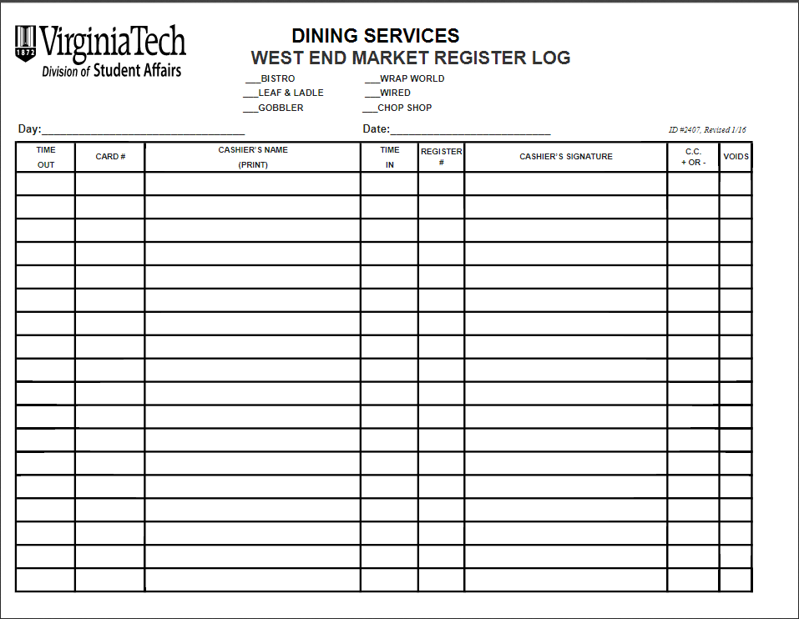
Paperwork – beginning of shift
You will fill out the Register Log each time you receive a clerk card from the kiosk.
When you are taking the clerk card from the kiosk, you’ll write the time you are signing the card out under “TIME OUT”, the CARD # and PRINT your NAME.
After your shift is over, you’ll write the time you are turning the card in under “TIME IN”, the number of the register(s) you used and then you will sign your name.
The last 2 columns are for office use.

Slide 12
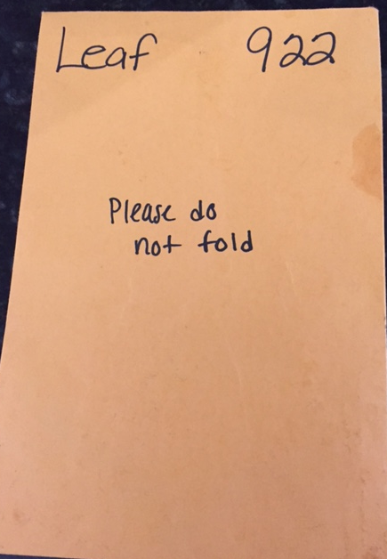
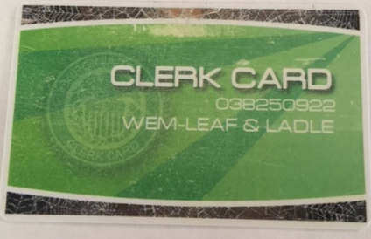
Using the Micros
To begin your shift as a cashier, you will need to go to the Kiosk and ask the attendant for a Clerk Card. Make sure you let them know which shop you are working in. Each shop has a different set of clerk cards.
The kiosk attendant will give you an envelope that has the shop and clerk card number on the outside. The actual clerk card will be inside this envelope. During your shift, use this envelope to store all of your credit card receipts, refund receipts, coupons, etc.
This is an actual clerk card. The last three digits of the long number are the number of your clerk card. It will also have WEM and the shop listed on it. You will swipe this card on the Micros to “sign in” to the register.

Slide 13
Using the Micros
You will be shown how to ring in orders when you go back to your shop.
Whenever you need to step away from the Micros, you will need to sign out. No one should be ringing orders under your clerk card. It’s a violation of policy and could result in disciplinary actions.
Never share clerk cards.
Smile.
Ask questions when you have them. Never assume the answer.

Slide 14
To Go containers
West End Market has several to go options available to our customers who choose not to dine in with us.
Compostable To Go Containers
These are our standard containers used when customers ask for their food “to go”
2 sizes – 9x9 and 6 in.
Each 9x9 container costs the customer $.20 ($.10 with the flex discount).
If a customer orders multiple items and the entire order will not fit into a 9x9 to go box, they are charged for each to go box used for their order.
If a customer orders food for here and then changes their mind and wants a to go box, then they must pay for it.
Reusable To Go Containers (Green To Go Boxes)
As an alternative to the compostable to go boxes, customers have the option of using a reusable to go box.
All staff and students with a Hokie Passports have been given 3 virtual tokens on their Hokie Passport.
One box is $7.00 Flex/$3.50 Cash or Hokie Passport. If someone paying with a credit card or loses their boxes, they can still buy into the program.
Customers inform the cashier they want their food in a reusable to go box and give the cashier an Ozzi token or the cashier swipes for a virtual token.

Slide 15
Virtual Token Reusable to go container process
Turns in to go container to Ozzi machine
Swipes Hokie Passport to get credit for container at Ozzi
Orders food in a reusable to go container
Cashier swipes Hokie Passport to remove Ozzi credit
West End Market, Owens Food Court and Turner Place participate in the Reusable To Go Container program. Each location has an Ozzi machine.
At West End Market, Bistro Firenze, Leaf and Ladle, JP’s Chop House and Fighting Gobbler Sports Lounge offer reusable to go containers.

Slide 16
Token Reusable to go container process
Customer purchases To Go Container at point of sale or gives cashier token
Turns in to go container to Ozzi machine
Gets an Ozzi token
Keeps token until next time
Orders food in a reusable to go container
West End Market, Owens Food Court and Turner Place participate in the Reusable To Go Container program. Each location has an Ozzi machine.
At West End Market, Bistro Firenze, Leaf and Ladle, JP’s Chop House and Fighting Gobbler Sports Lounge offer reusable to go containers.

Slide 17
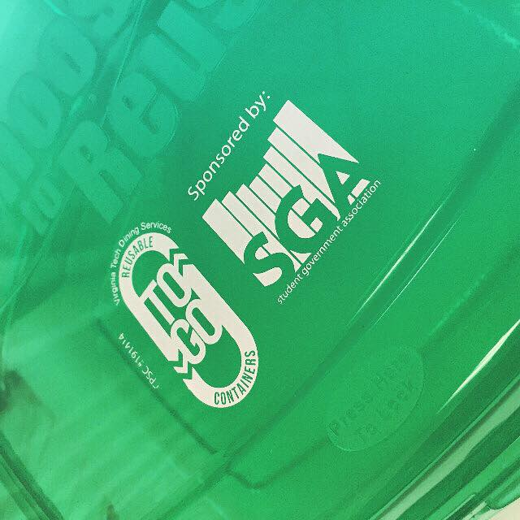
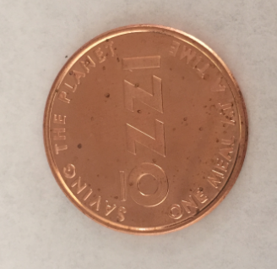
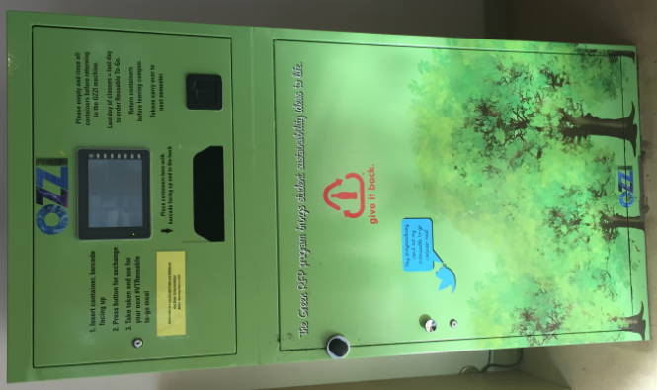
Reusable to go containers and Ozzi
Ozzi Tokens
Green reusable to go box
The Ozzi Machine

Slide 18
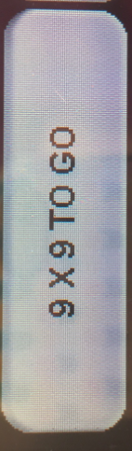

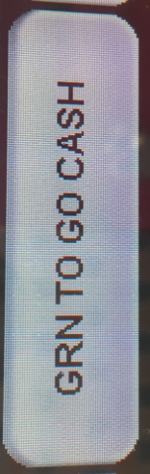
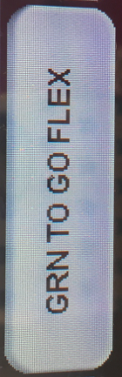
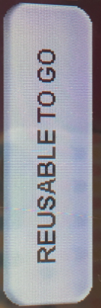

To Go buttons on the register
This button is on the “home” screen and will give you access to the buttons below.
Charges $.20 for a 9x9 to go box
When a customer wants to purchase a green to box and is paying with debit, credit or Hokie Passport; the charge should be $3.50
When a customer wants to purchase a green to box and is paying with their Flex Meal plan; the charge should be $7.00, which will be discounted to $3.50.
Use this button when a customer gives you an Ozzi token only; there is no need to use this button after you have used either the GRN TO GO CASH or GRN TO GO FLEX buttons
For the 6 inch to go boxes that have no cost associated with them or if you need to let someone know it’s to go but there doesn’t need to be a charge

Slide 19
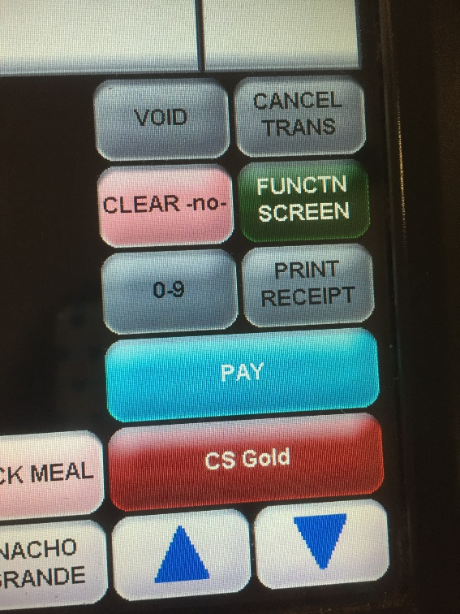
Payments
After you finish ringing in the order(s), you will need to process their payment. These buttons on the left are how you process payments.
If you are handed a Hokie Passport, 99% of the time you will just need to hit CS GOLD and swipe their card and you’re done.
For the 1% and for credit card payments, you will need to hit PAY which takes you to the screen on the next slide.

Slide 20
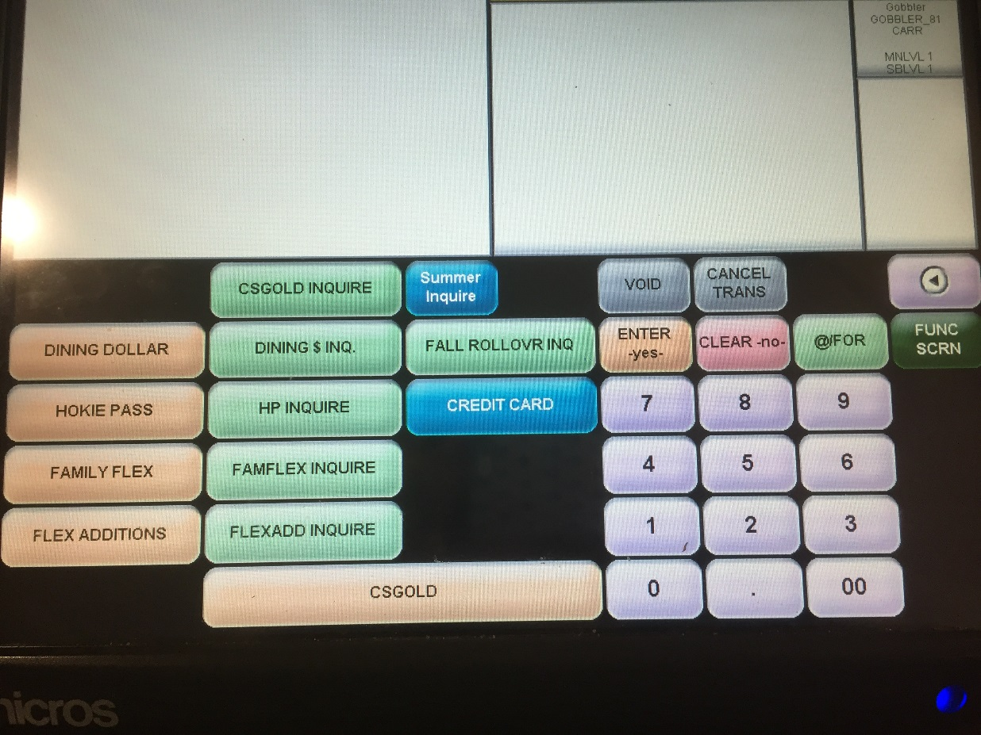
Payments
This is the payment screen (you get here by pressing the blue PAY button shown on the previous slide).
Press the corresponding ORANGE button when processing a payment. If a customer says to use their HOKIE PASSPORT funds, you would press the ORANGE HOKIE PASS button and swipe their card.
The LIGHT GREEN buttons allow to INQUIRE as to how much money a customer has in a certain account. Sometimes, when you process a payment, a customer won’t have enough money in that account to pay for their purchase. You will be able to check other accounts to see if they have other funds available.
Press the BLUE CREDIT CARD button after you have processed the credit card on the credit card machine and it has been approved.

Slide 21
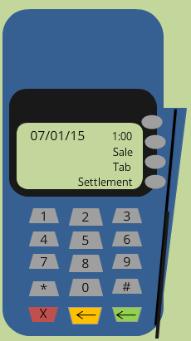
Payments how to use the credit card machine
Swipe the customer’s card.
Enter the amount of the transaction in to the credit card machine. Make sure that it’s the total including tax from the Micros.
Enter the last 4 digits of the credit card number.
Enter the last 2 digits of your clerk card number.
After the payment is approved, a receipt will print. Keep this receipt and when prompted, print a copy of the receipt to give to the customer.
Always make sure the receipt shows that the transaction was approved.
Press CREDIT CARD on the Micros under the payment screen.
Staple the credit card receipt on top of the receipt from the Micros.
Things to remember when using a credit card…
Credit cards should only be used in person
NEVER WRITE DOWN A CREDIT CARD NUMBER!!!
Never allow unauthorized personnel to work on the credit card terminal. If you have any doubts, get a manager.
Credit card security is very important and it’s important we protect our customer’s information.
If you need a refund performed with a credit card, get a manager immediately and do not allow the customer to leave.
TRAINERS – Be sure to go over the Payment Card Security and Confidentiality Agreement with employees!

Slide 22
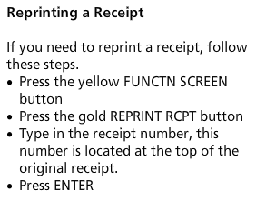
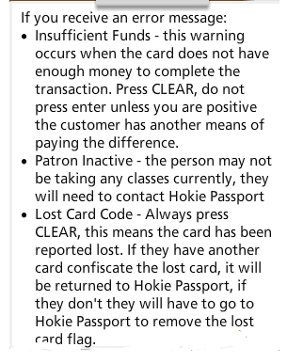
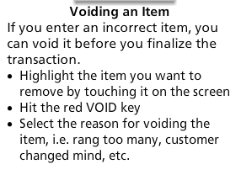
Payments
A few more credit card tips…
If you are asked for a customer ID, or any type of ID for the customer (on the CC machine), just press enter.
Sometimes the CC machine will ask you for the tax amount, leave it as $0.00 and press enter.

Slide 23
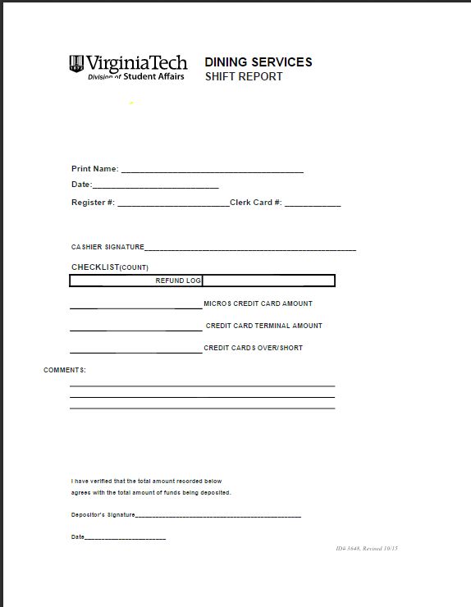
Paperwork – End of Shift
You will fill out the SHIFT REPORT at the end of your shift only if you have credit cards. If you don’t have credit cards, you will not need to fill this form out. You can just sign your card back in to the kiosk.
If you have credit cards, you will need to print off your MICROS CLERK CARD REPORT and SERVER DETAIL CREDIT CARD REPORT. You’ll need both of these to complete your Shift Report.
Instructions for printing them are at each register but the best way to learn will be to have a co-worker show you.
You will print your name, the date, your register number(s) and clerk card – LEGIBILY.
Sign your name here
The Micros My Employee Report and the Server Detail Report from the credit card machine should match. If they DO NOT MATCH, use the adding machine to total your credit card receipts to find the discrepancy. You will also need to find a manager as soon as possible.
You will write the totals from your Micros Report and Server Detail report on the corresponding lines on the shift report. If they do not match up, you will write the discrepancy on the Over/Short line. If you have a discrepancy, you will need to add up all of your credit card receipts with the calculator. You should explain any overages or shortages on the comment lines for the depositor to read in the morning. You also need to get a manager if any of your totals to do not match. We need to try to figure out the problem before you leave.
The first time you fill out your shift report, ask someone one in your shop to help you. This is a lot of information that will make better sense if you’re shown exactly what we want.

Slide 24
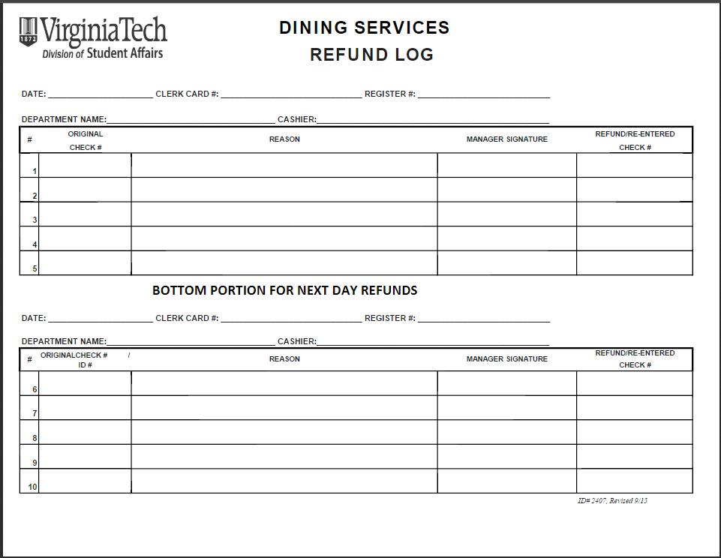
Refunds and refund logs
When a refund is needed to correct a mistake after the payment has been processed, please get a manager as soon as possible. Do not leave your register unattended to get a manager.
Credit card refunds need to be performed immediately and before the customer leaves, so have someone in your shop get a manager right away. Please do not leave your register unattended with customers waiting.
If it’s a refund on their Hokie Passport card, we can perform the refund after they’ve left if they are unable to wait. Refunds must be done before you leave for the day and turned in with your cashier paperwork. Do not leave refunds in the shop for a manager to find.
NEVER write down a customer’s name and/or Hokie Passport number/credit card number. NEVER!
Management must have the original receipt, with the error, in order to perform the refund.
Management needs at least 2 receipts, sometimes 3, attached to the refund log
The receipt with the mistake
The receipt with the refund
The receipt with the correct charge (did you charge them for item X when they ordered item Y or Z?)
If you’re waiting until later to do have a refund performed…
Please make sure you circle want needs to be refunded and why it needs to be refunded.
If you charged the customer for the wrong item, charge them for the correct item(s) while they are still here.
Inform the customer the refund will be completed by the end of the business day.
Make sure you fill out a refund log and attach it to your shift report.

Slide 25
Offline procedures
Occasionally the Micros system will go offline. When this happens, OFFLINE will appear in the upper right hand corner. The Micros will also give you a warning saying “Offline.”
As soon as you see Offline or receive the offline message, inform a manager.
You can still take orders while the Micros is offline. However, balances on cards will not be displayed and Flex plans will not receive the 50% discount while offline. The discount will be applied once the system is brought back on-line. It’s important that you communicate this to the customer.

